Slide 1
Extract deidentified SPEP/IT data from Phoresis
Floris Chabrun
University Hospital of Angers

Slide 2
Install PostgreSQL
https://www.postgresql.org/download/windows/

Slide 3
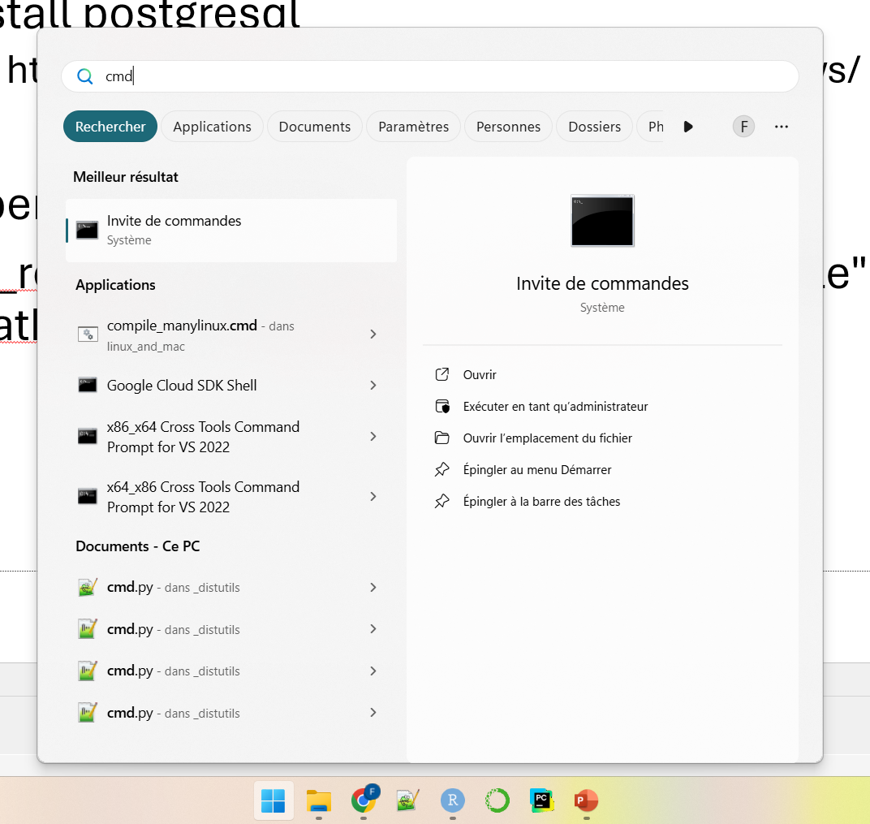
PostgreSQL
Windows key
Type « cmd »
Open command prompt

Slide 4
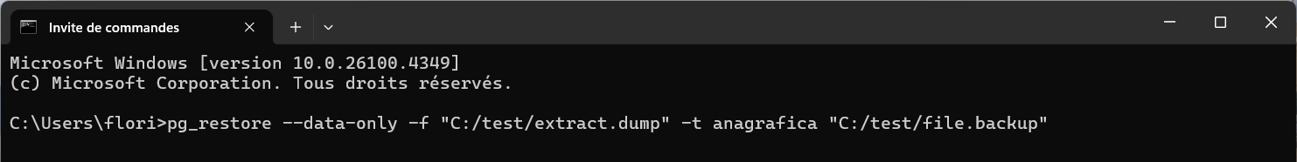
PostgreSQL
Type pg_restore --data-only -f "output_path/extract.dump" -t anagrafica "input_path/file.backup" then Enter
output_path/extract.dump = path to the file that will be created; specify « extract.dump » into an existing directory
input_path/file.backup = path to an existing Phoresis archive backup file (e.g. « Total_11_05_2024.backup »)
e.g.:

Slide 5
R script
In R, open the R extract IS postgre.R script
Change the path at line 2 of the R script (working_directory variable definition) to the path in which the « extract.dump » file was exported during previous step
« Working directory » must be the path to a DIRECTORY containing the output file, and the output file must be named « extract.dump »
The deidentified dataset and matching table will be saved in the same directory
Run the full script (this may take several minutes depending on the size of the database)
Check that the match table (EXPORT_MATCH_TABLE.csv) and deidentified dataset (EXPORT_DEIDENTIFIED_DATASET.csv) were successfully created into the working directory

